Slide 1
Collectıng transcrıptıon
Mert Can cakmak

Slide 2
Outlıne
Get Transcriptions of Youtube Videos
Finding Transcriptions for No Caption Videos using Whisper
Translating Non-English Transcriptions
Connecting All Transcriptions

Slide 3
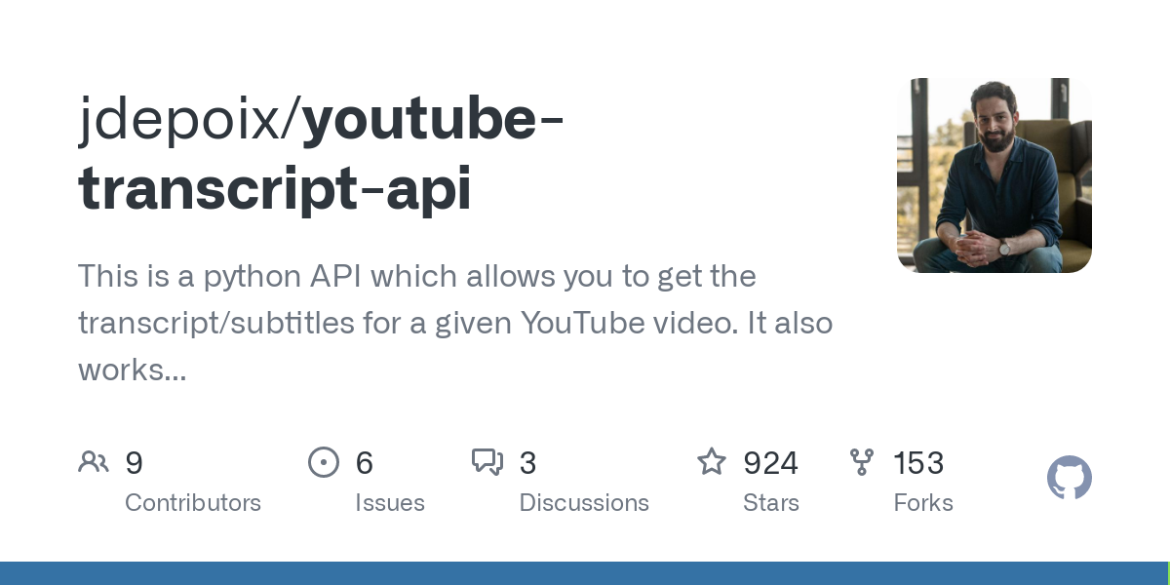
1- Get Transcriptions of Youtube Videos using youtube-transcript-apı
Video IDs
14332
Uniquely: 5686
Gathers the transcriptions that are auto-generated or created by people.
Disabled Transcription Video Count = 1721
Uniquely = 723
No Transcription
Labeled as

Slide 4
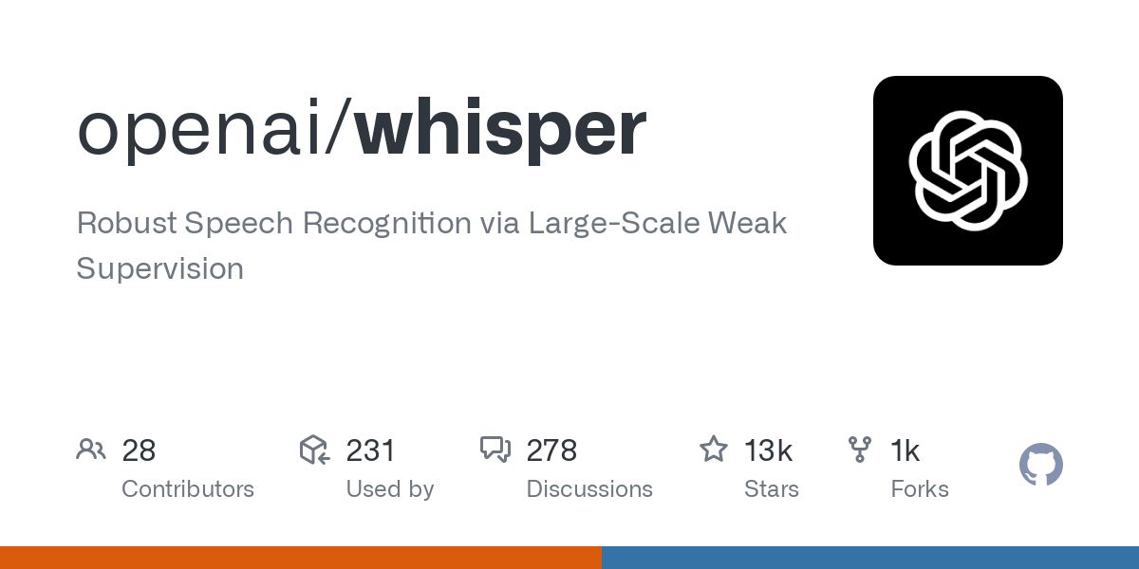
2- Finding Transcriptions for ‘No TRANSCRIPTION’ Videos using Whisper tool
No Transcription Videos:
YouTube link of Unique Video IDs
Transcriptions of both English and mixed languages.
Count of Videos that are Not Available, Live Show, Removed and NULL: 154
Not Video
Labeled as

Slide 5
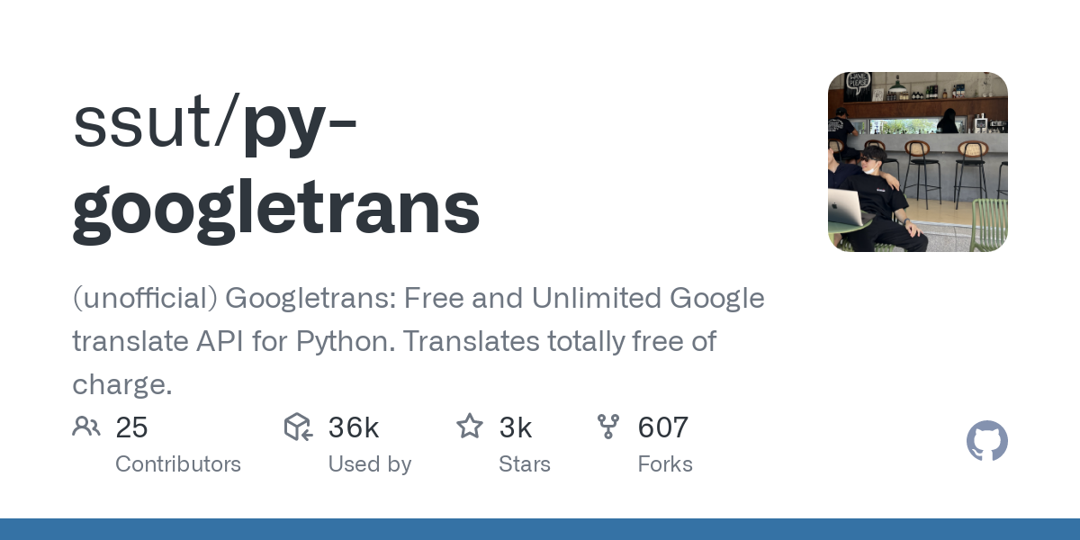
3- Translating Non-English Transcriptions INTO ENGLISH
Transcriptions of both English and mixed languages.
English translations of transcriptions
Out of 569 videos 34 videos’s transcriptions were Not English
Since googletrans has 5000 character limit, in every slices the language is detected and the percentage calculated.
The language of translations detected. If the total percentage of English < 80% it is labeled as Not English

Slide 6
4- Mergıng All Transcriptions
The transcription of 535 Unique Video has found.
“No Transcription” label is changed with actual transcriptions for these videos.
Other “No Transcription” videos are dropped.
Finally the total number of transcriptions were:
13787
Uniquely: 5498

